Slide 1

LIFE EXPECTANCY CALCULATION
Life Expectancy Calculation using machine learning has emerged as a promising application in the field of healthcare and data science. In this project, we developed Machine Learning Models to calculate Life Expectancy. Through this exploration, we aim to demonstrate the potential of machine learning in improving our understanding of longevity and its implications across various domains.
By Steshi

Slide 2
What is Life Expectancy?
Definition
Factors
Global Trends
Life expectancy is the average number of years a person is expected to live, given their demographic and health factors.
Life expectancy is influenced by factors such as gender, lifestyle habits, access to healthcare, genetics and many more.
The global average life expectancy has risen from 48 years in 1950 to 72 years in 2019.

Slide 3
Importance of Life Expectancy Prediction
Long-term Investments
Insurance companies and pension funds rely on accurate life expectancy predictions to manage their long-term investments.
1
2
3
Healthcare Planning
Population Studies
Predicting life expectancy can help healthcare providers plan for future demands and allocate resources efficiently.
Lifespan predictions can help researchers study the effects of environmental and lifestyle factors on different populations.

Slide 4
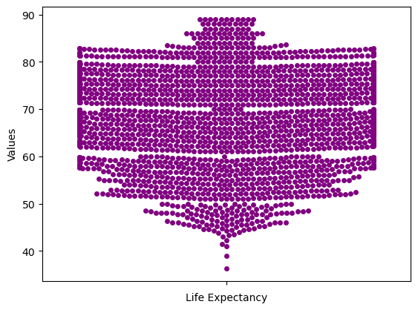
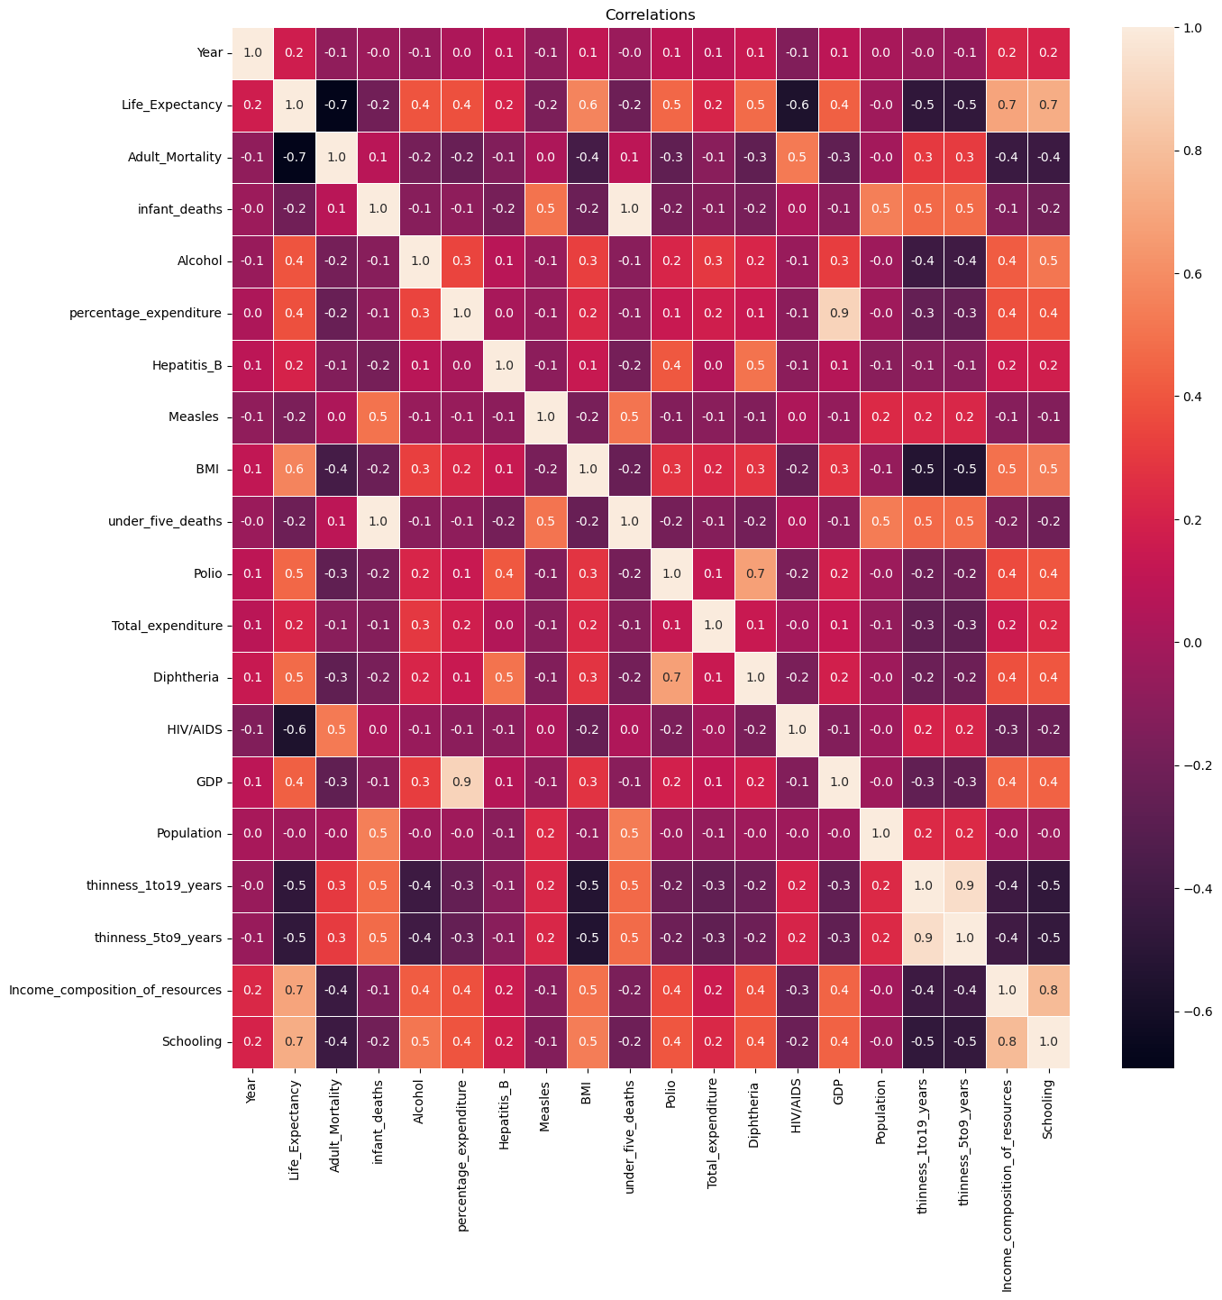
Data Processing and Visualization
The dataset was collected, the dataset is not always ready to use. We first cleaned the dataset to fill the null values with the mean values of the corresponding features and the remaining values were removed. The features which are not useful for regression model were also removed. Features of the dataset were extracted using machine learning techniques to identify patterns and correlations. The visualization of the target variable and the heatmap are shown:

Slide 5
Linear Regression
Definition
Strengths
Limitations
Linear regression is a statistical model that assumes a linear relationship between the dependent variable (life expectancy) and one independent variable.
Linear regression is simple to implement and interpret. It also provides a correlation coefficient that measures the strength of the relationship.
Linear regression assumes a linear relationship between variables, which may not be true in all cases and may also be sensitive to outliers.

Slide 6

Multivariate Linear Regression
1
Definition
2
Advantages
Multivariate linear regression involves predicting life expectancy using multiple independent variables.
Multivariate linear regression allows for the incorporation of multiple factors that influence life expectancy, resulting in more accurate predictions.
3
Pitfalls
Multivariate linear regression is sensitive to multicollinearity and requires careful selection of independent variables to avoid overfitting.

Slide 7
Polynomial Regression
1
2
3
Order 1
Order 2
Order 3 and higher
Definition: Linear relationship
Definition: Quadratic relationship
Definition: Higher degree polynomial relationship
Advantages: Simple and easy to interpret
Advantages: Can capture upward or downward curvatures
Advantages: Can capture complex and nonlinear relationships
Pitfalls: May not capture curvilinear relationships between variables
Pitfalls: May overfit with larger sample sizes
Pitfalls: May overfit with small sample sizes

Slide 8
Multivariate Polynomial Regression
Definition
Advantages
Pitfalls
Multivariate polynomial regression involves predicting life expectancy using multiple independent variables and high degree polynomial equations.
Multivariate polynomial regression can capture complex relationships between variables, leading to more accurate predictions than simple linear models.
It requires careful selection of independent variables and choosing the right degree of polynomial. High-degree polynomials can overfit the data, leading to poor generalization ability.

Slide 9
Comparison of Model Performance
Model
R2_score
Mean Absolute Error
Mean Squared Error
Linear regression
0.52
4.89
44.87
Multivariate Linear regression
0.809
3.13
17.82
Polynomial Regression
0.63
4.17
32.65
Multivariate Polynomial Regression
0.89
2.22
9.59

Slide 10

Conclusion
It can be concluded that employing ML for Life Expectancy Calculation enhances prediction accuracy, provides deeper insights into influencing factors and enables more informed and targeted decision-making in healthcare and public policy. The analysis of life expectancy using all the four models shows that the Multivariate Polynomial Regression model achieved the highest R-squared(r2) score among the models. This implies that considering multiple variables and using a polynomial relationship improved the accuracy of the predictions.

